Slide 1
Repurposing City Centres with Big Data: Data, Models and Policy Applications Dr. Patrick Ballantyne, Prof. Scott Orford

Slide 2
Repurposing City Centres with Big Data: Today’s Talk
Consumer Data Research Centre (CDRC): An Introduction
CDRC Retail Centres: Data, Models and Policy Applications
WISERD: An Introduction
Understanding Welsh Places: Comparator Tools

Slide 3
Vast amounts of consumer data are generated each day in the UK.
Repurposing City Centres with Big Data: The CDRC

Slide 4
Vast amounts of consumer data are generated each day in the UK. It’s not just businesses that benefit from analysis of these data … researchers are able to use consumer data to study what’s going on in society today.
Repurposing City Centres with Big Data: The CDRC

Slide 5
Vast amounts of consumer data are generated each day in the UK. It’s not just businesses that benefit from analysis of these data … researchers are able to use consumer data to study what’s going on in society today. The CDRC was established to lead academic engagement between industry and the social sciences.
Repurposing City Centres with Big Data: The CDRC

Slide 6
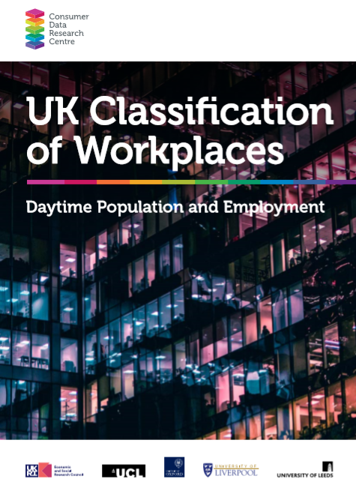
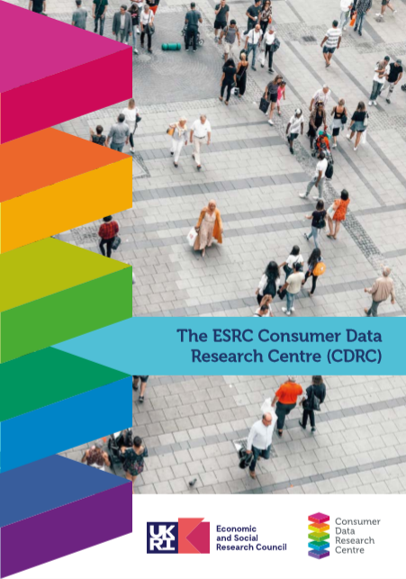
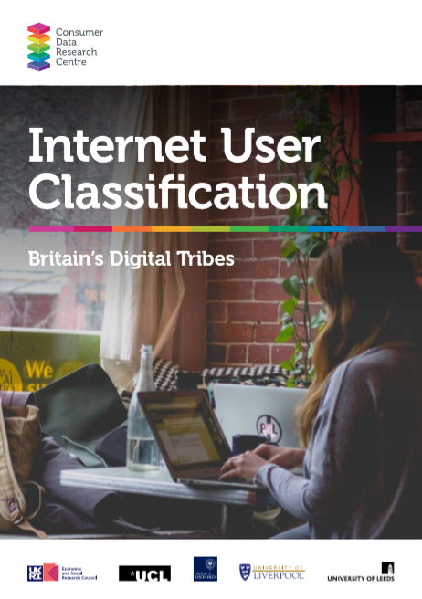
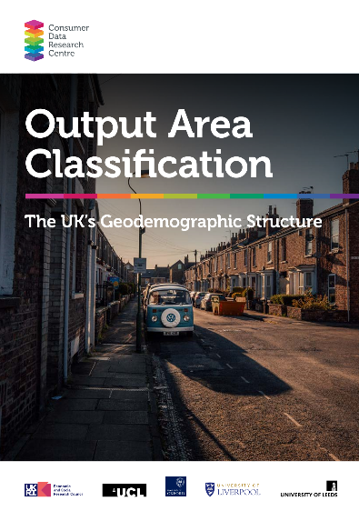
Repurposing City Centres with Big Data: The CDRC Model
Open
User Demand
Safeguarded
Controlled
Simplicity of Access
Notes:
Analysis ready data products; access model

Slide 7
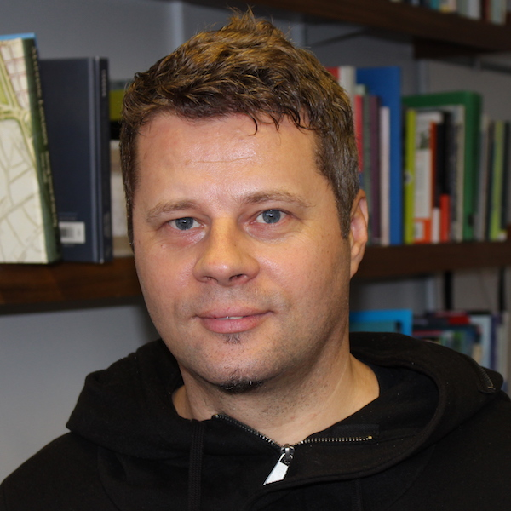
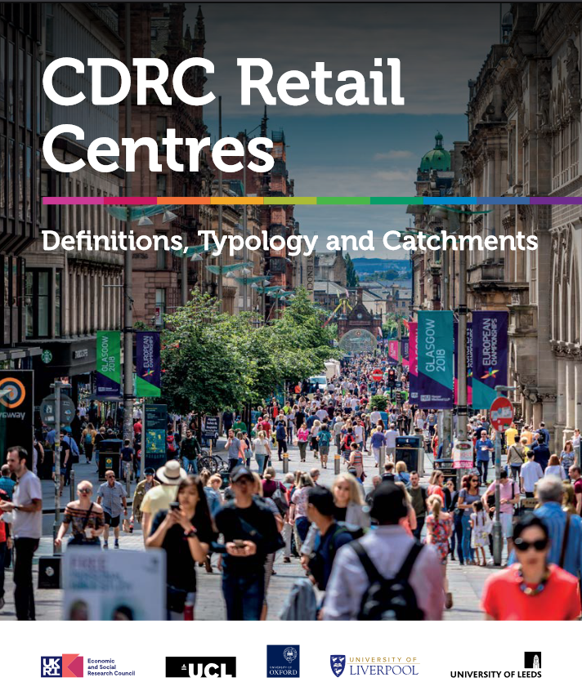
Repurposing City Centres with Big Data: CDRC Retail Centres

Slide 8
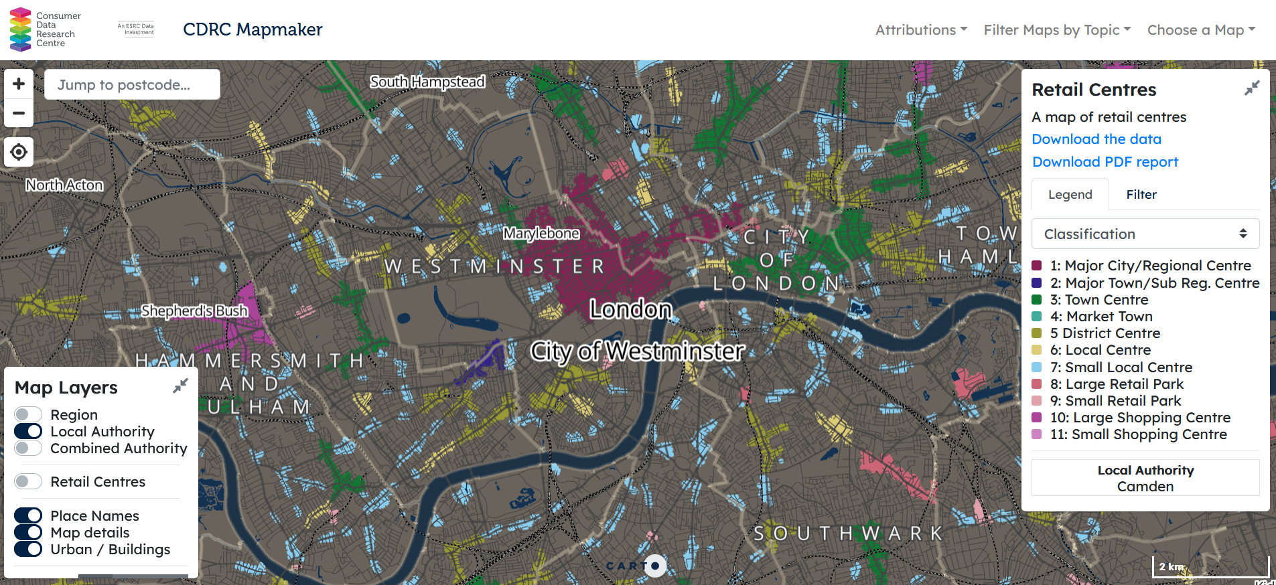
Repurposing City Centres with Big Data: Location
Notes:
Unit of geographical analysis, attaching other forms of data and looking at morphology of town centres over time

Slide 9
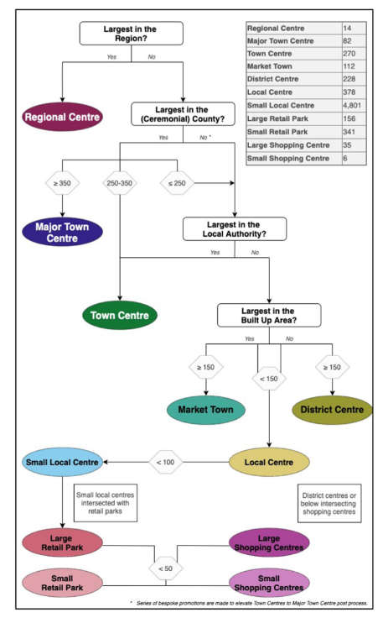
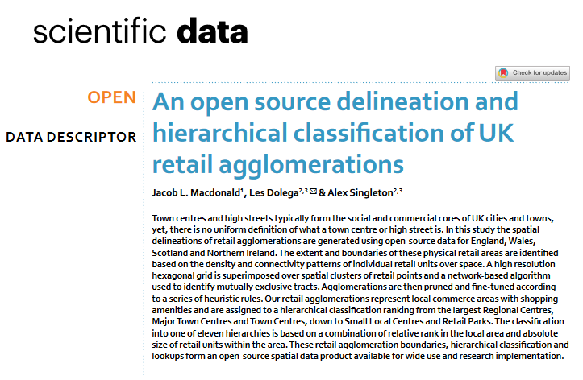
Repurposing City Centres with Big Data: Form and Function
Notes:
Accessible, interpretable means of understanding function of retail centres

Slide 10
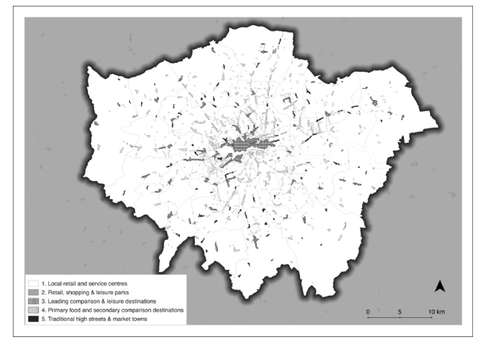
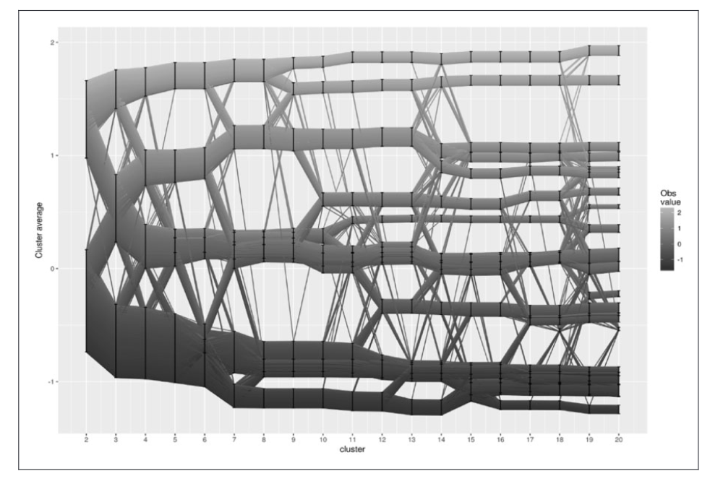
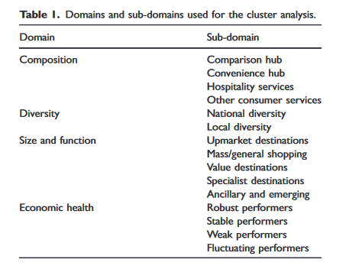
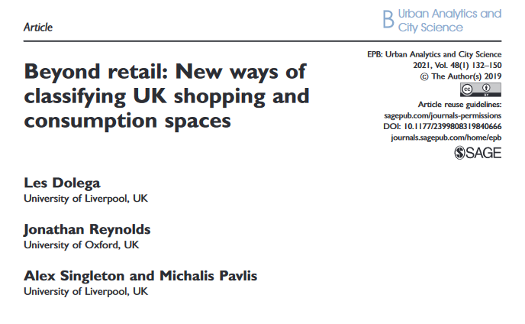
Repurposing City Centres with Big Data: Form and Function (2)
Notes:
Multidimensional, data-driven, understanding form and function of retail centres in unfamiliar settings

Slide 11
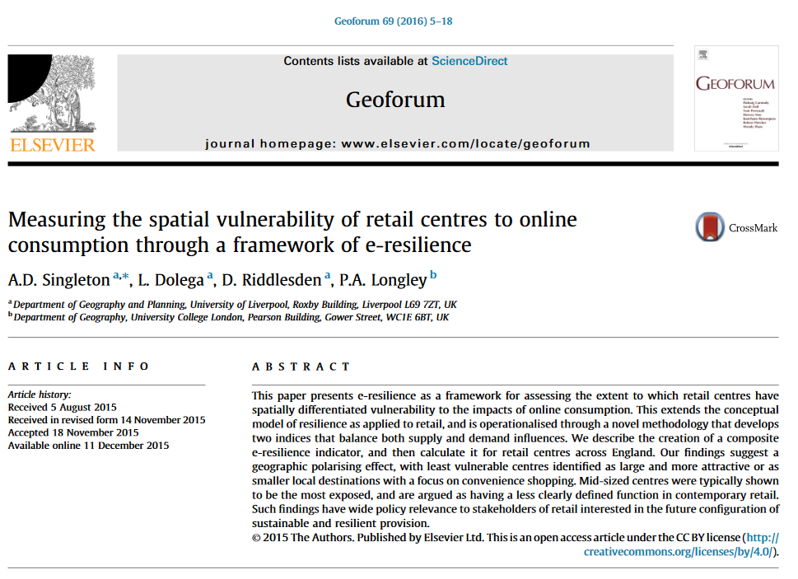
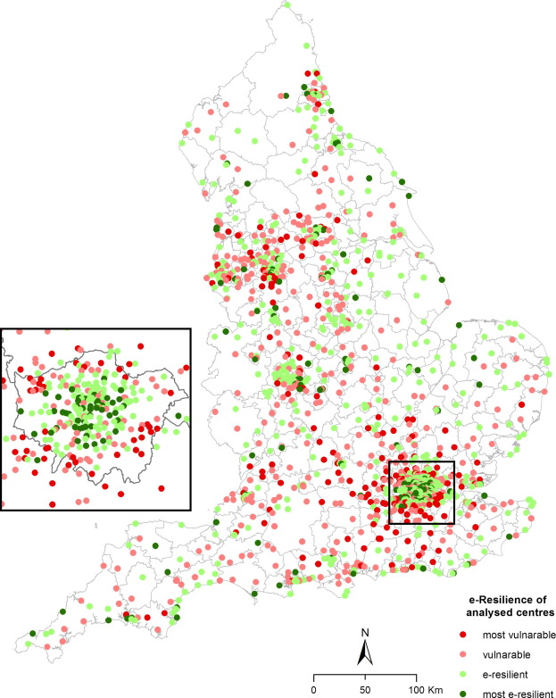
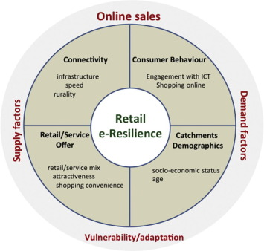
Repurposing City Centres with Big Data: E-Resilience
Notes:
External pressures, quantifying their impacts on retail and city centres.

Slide 12
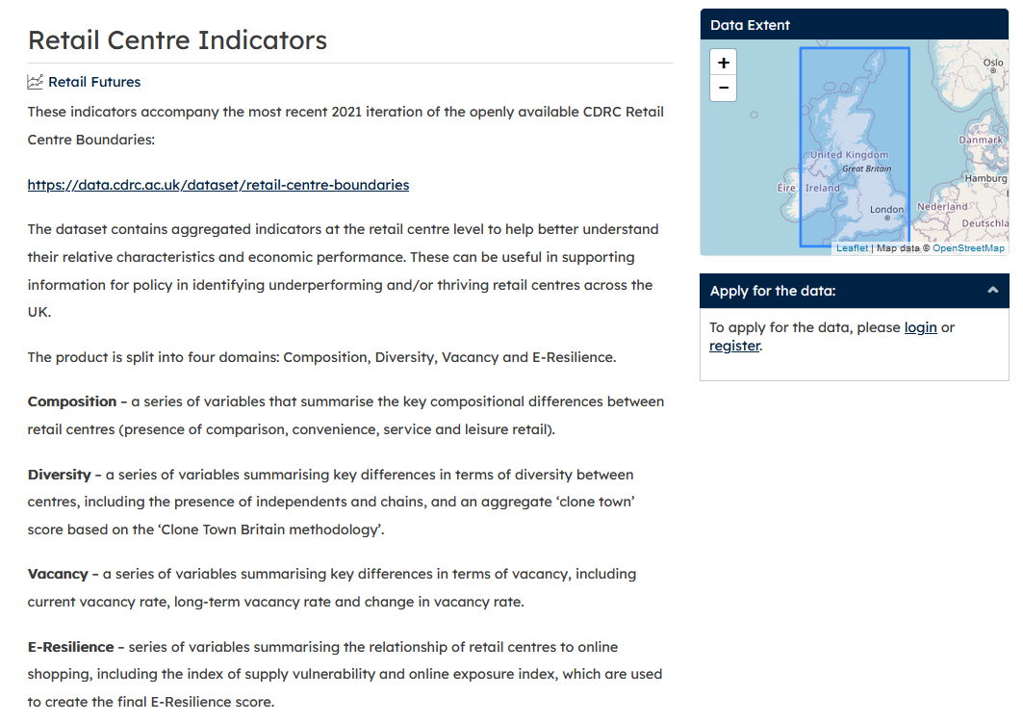
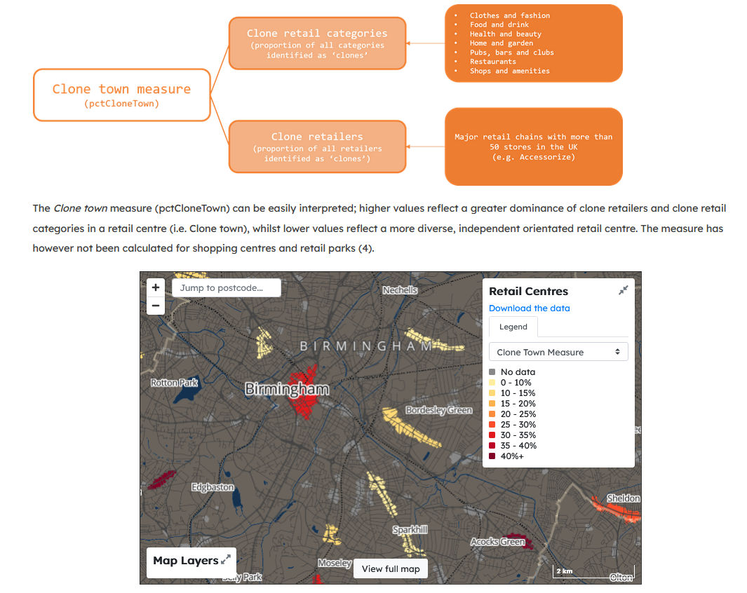
Repurposing City Centres with Big Data: Indicators
Notes:
Indicators provide a useful snapshot of performance and characteristics of retail centres, but can be updated and expanded based on available data

Slide 13
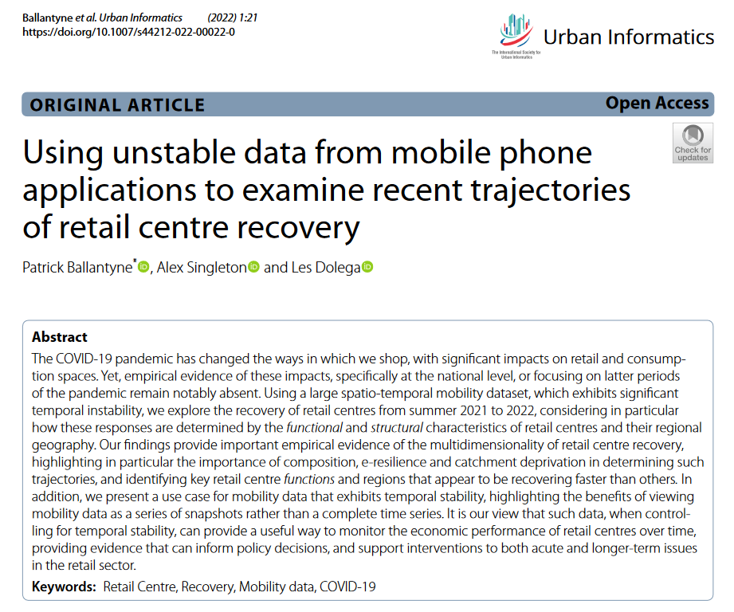
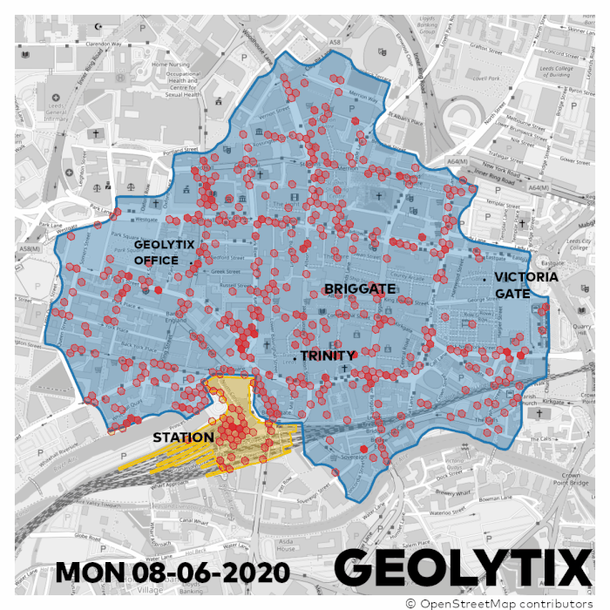
Repurposing City Centres with Big Data: New Forms of Data
Notes:
New approach to examining performance of retail centres, using mobile phone data. Mechanisms for recovery, but also alternative to footfall measurement which is problematic.

Slide 14
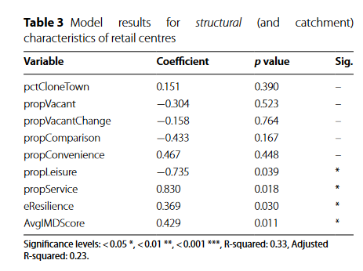
Repurposing City Centres with Big Data: New Forms of Data
Notes:
New approach to examining performance of retail centres, using mobile phone data. Mechanisms for recovery, but also alternative to footfall measurement which is problematic.

Slide 15
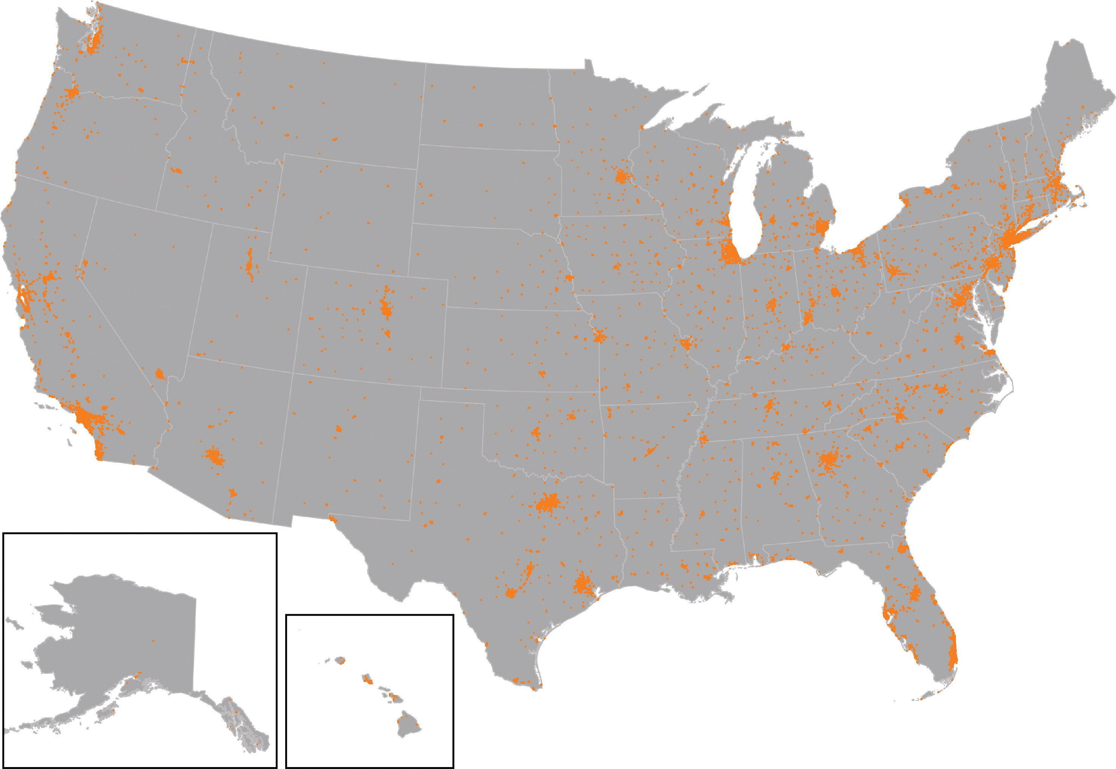
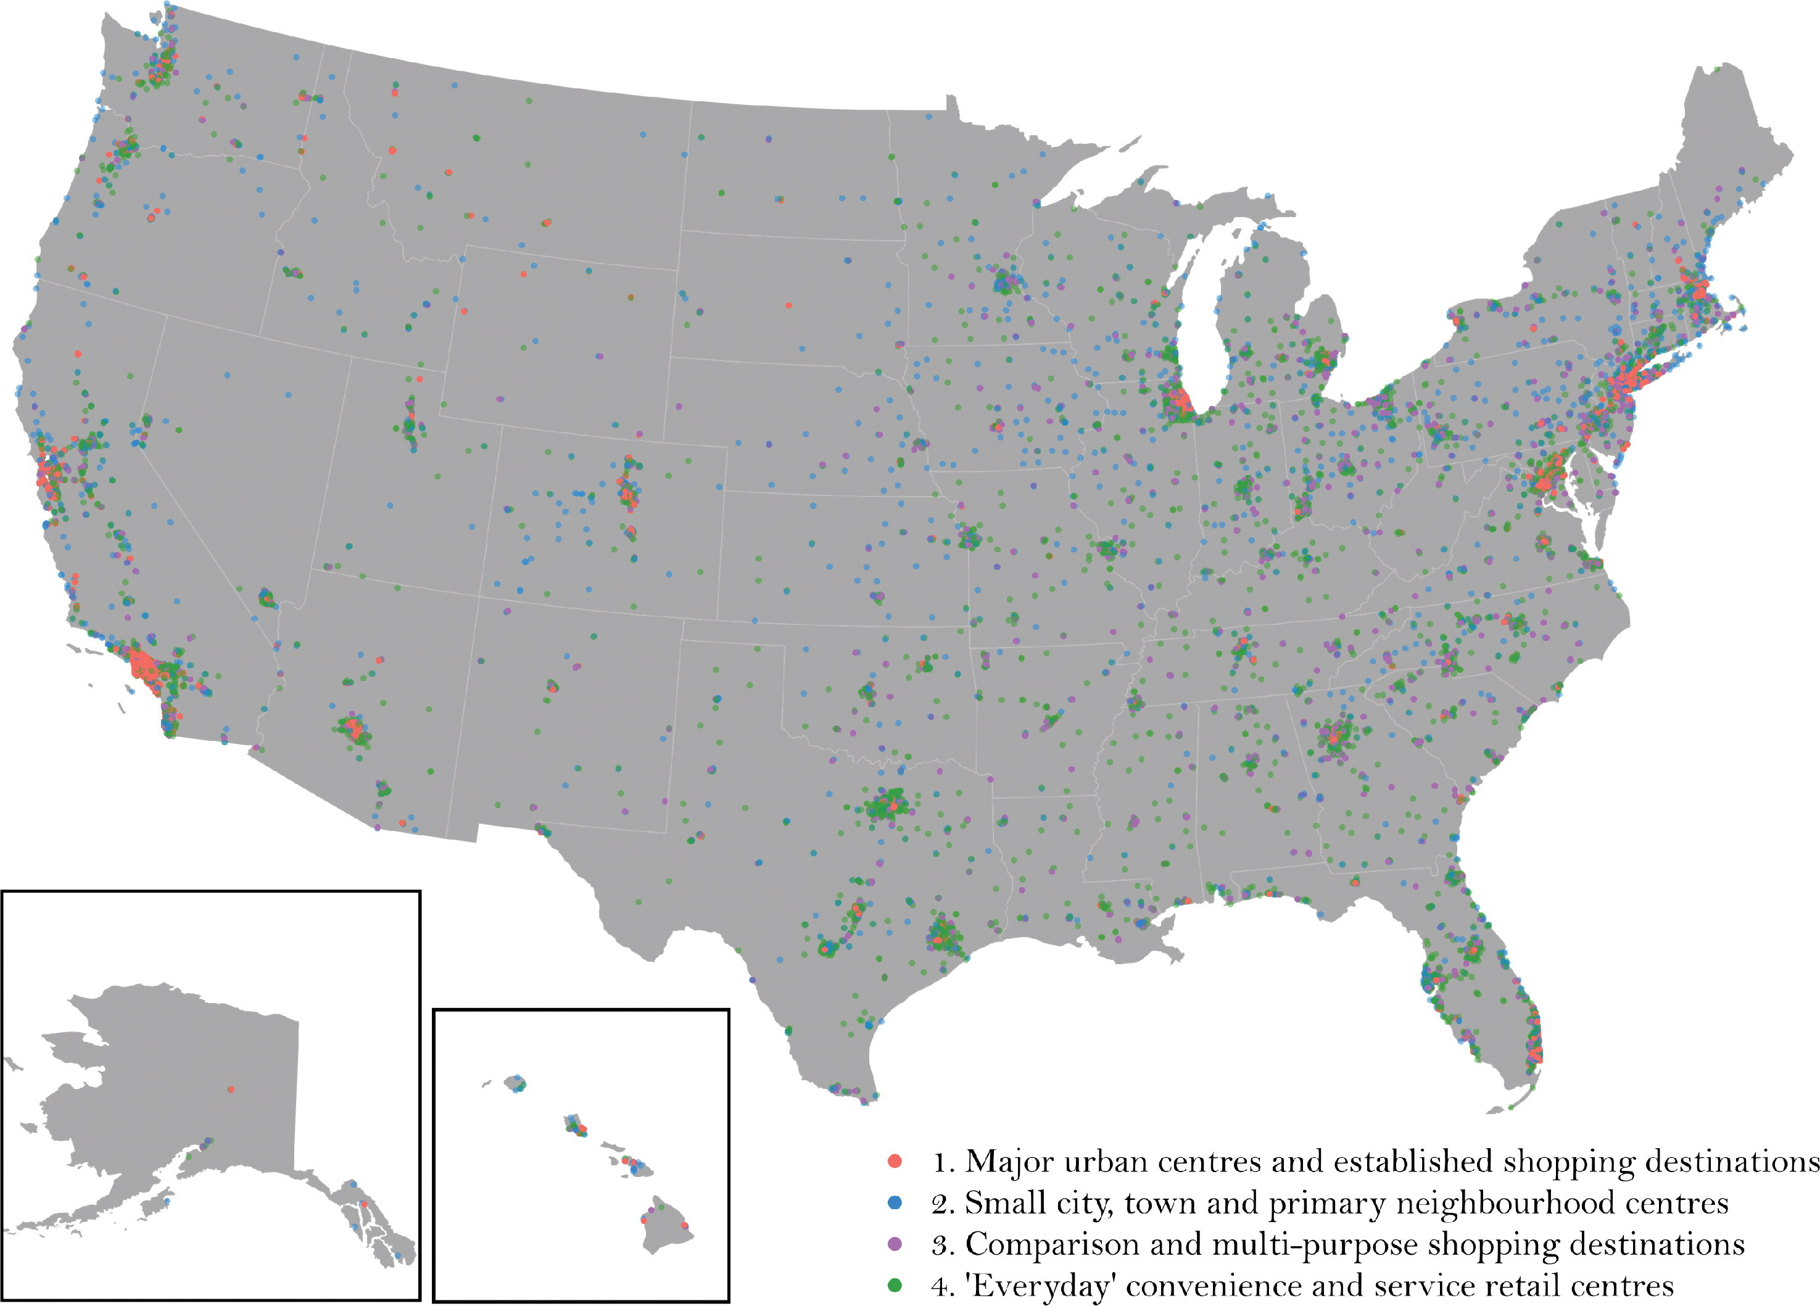
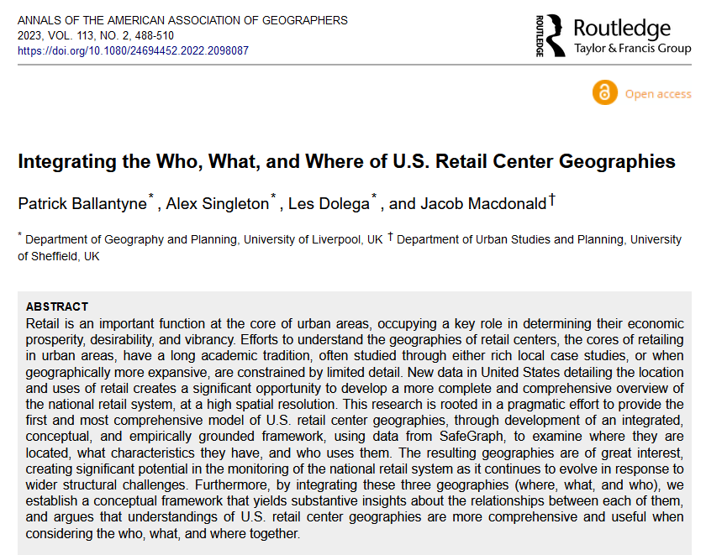
Repurposing City Centres with Big Data: International Comparisons
Notes:
Using data-driven frameworks for understanding our retail and city centres, we can extend such analyses into new locations, especially because the frameworks can be customised to suit the location of study, comparative analyses become much easier.

Slide 16
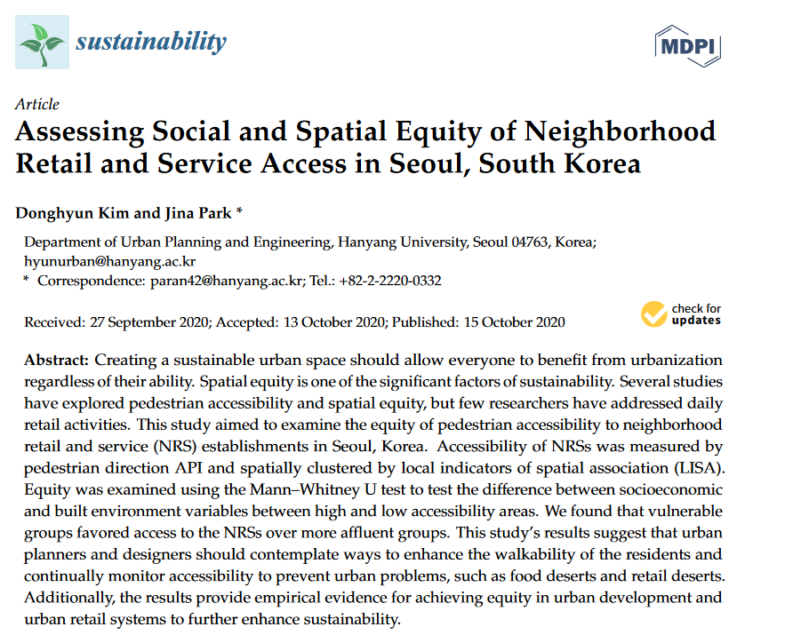
Repurposing City Centres with Big Data: International Comparisons (2)
Credit: Bogang Jun, Assistant Professor, Inha University
Jina Park, Professor, Hanyang University
Notes:
Some examples of this stuff in S. Korea; we are looking to put a grant in soon on some of this retail stuff in Korea with our visiting Prof, open to collaborators if anyone is interested. Specifically around vulnerability of Korean commercial centres to external pressures (e.g., online shopping, experiential retailing etc.).

Slide 17
Repurposing City Centres with Big Data: Get Involved!
data.cdrc.ac.uk
SCAN ME
Notes:
Key points:
Data is important for helping us understand the current system of retail and city centres, but we can also use data to understand how they are repurposing and evolving in response to some of these external pressures.
Infrastructure like the CDRC makes this more feasible; bringing together a portal of data on retail centres in an accessible manner to facilitate such insights.

Slide 18
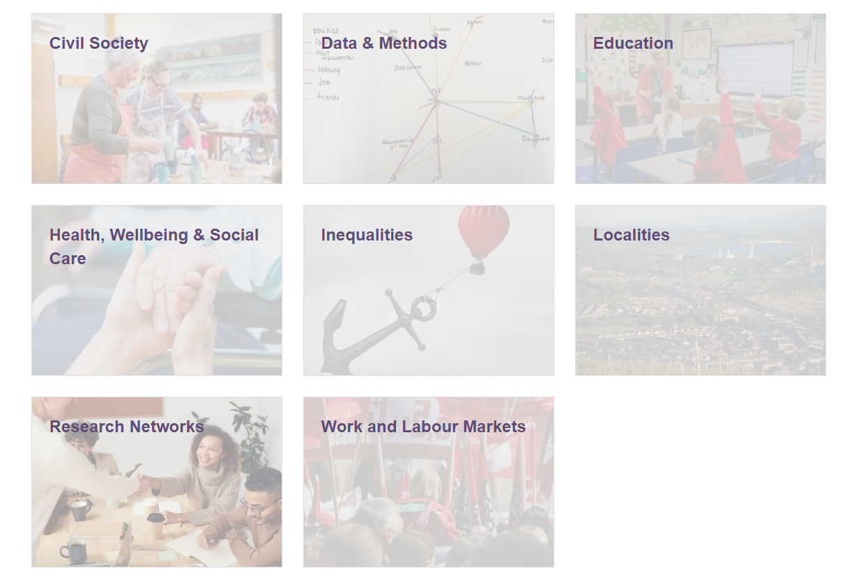
Wales Institute of Social and Economic Research and Data
WISERD Data Team
Notes:
Scott this is where you can take over…

Slide 19
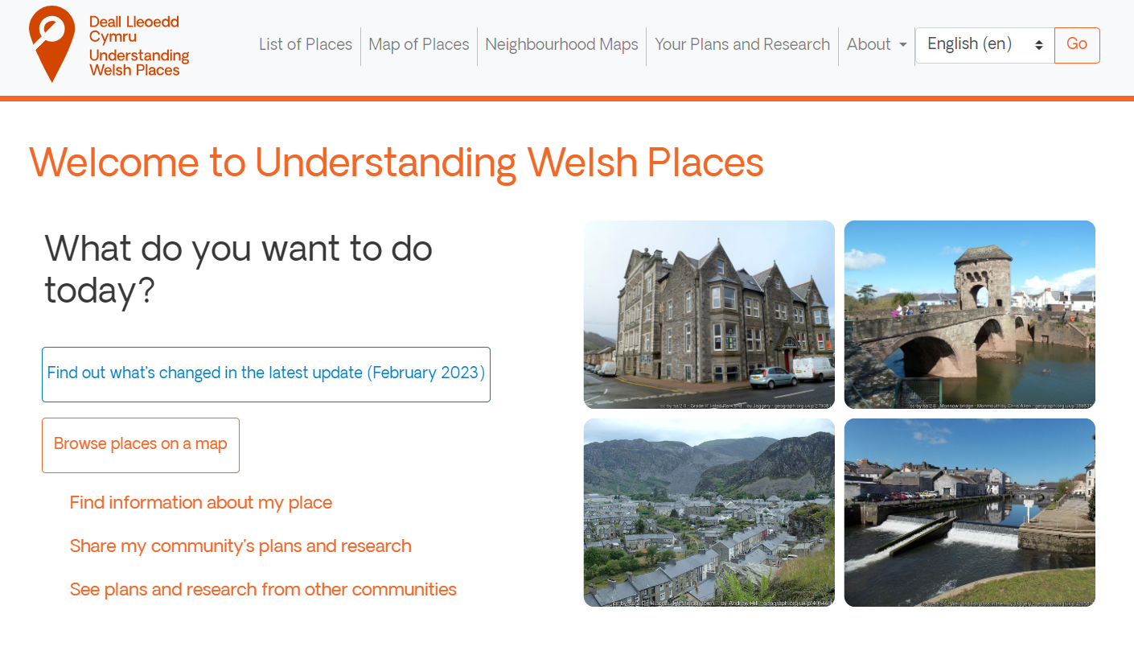
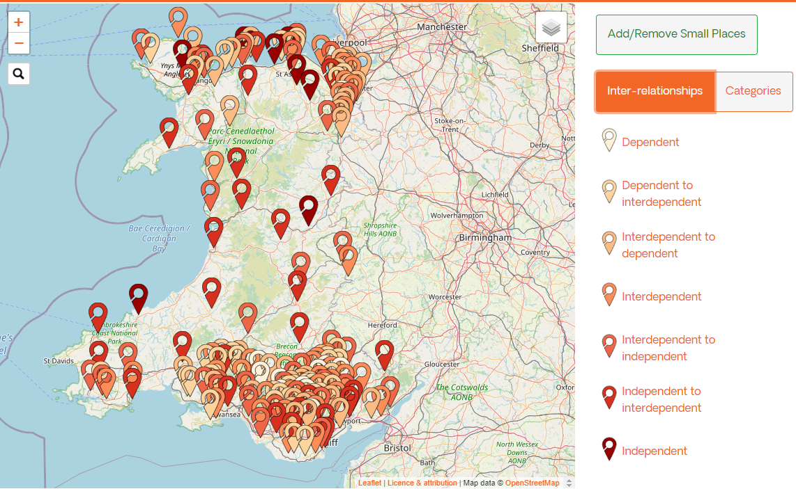
http://www.understandingwelshplaces.wales/en/
Notes:
Scott this is where you can take over…

Slide 20
Understanding Welsh Places: a town comparator tool
Notes:
Scott this is where you can take over…

Slide 21
Understanding Welsh Places: a town benchmarking tool
Notes:
Scott this is where you can take over…

Slide 22
Place Connectivity: flows of people and transport accessibility
Notes:
Scott this is where you can take over…

Slide 23
Understanding Welsh Places: Informing Policy Research
Notes:
Scott this is where you can take over…

