Slide 1
Using Urban Indicators to Deliver a Sustainable and Equitable Future for Liverpool City Region AAG Annual Meeting 2024, Honolulu Geography and Data Science for Public Good II: Data-Driven Evidence and Solutions to Social and Spatial Inequalities Patrick Ballantyne, Alex Singleton, Gabriele Filomena, Francisco Rowe Geographic Data Science Lab, University of Liverpool In collaboration with Liverpool City Region Combined Authority (LCRCA)

Slide 2
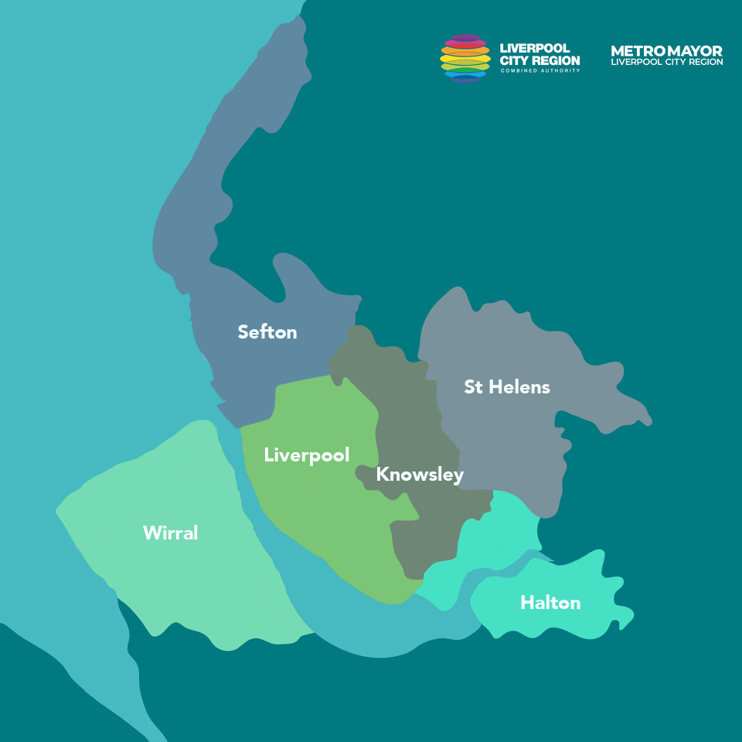
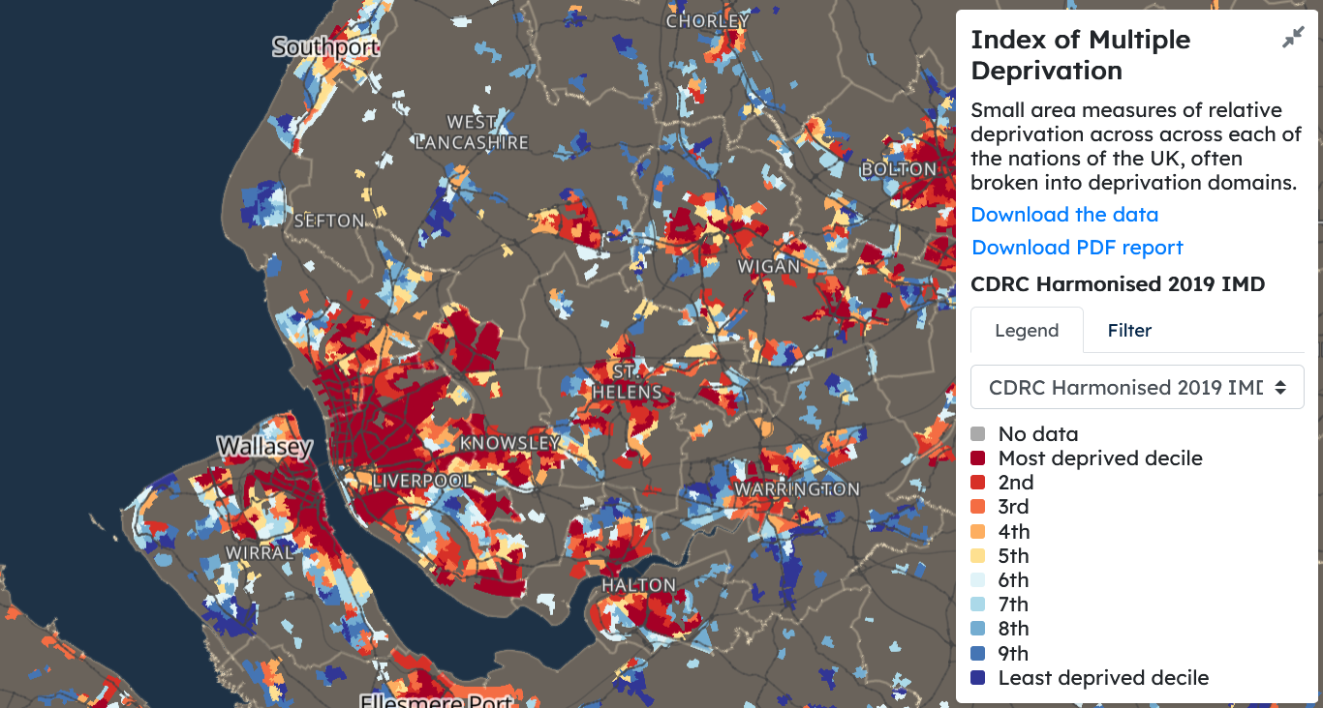
Liverpool as a “City of Inequality” (Sykes, 2013)
Strategic powers:
Question:
Can we develop urban indicators that better represent local patterns of inequality and policy frameworks?
Scale? Context? Purpose?
Spatial inequalities can be seen as a representing national and local issues
Devolution: “policymaking at a more localised scale”
Urban indicators + Devolved funding = Evidence-led decision-making and investment
Case Study

Slide 3
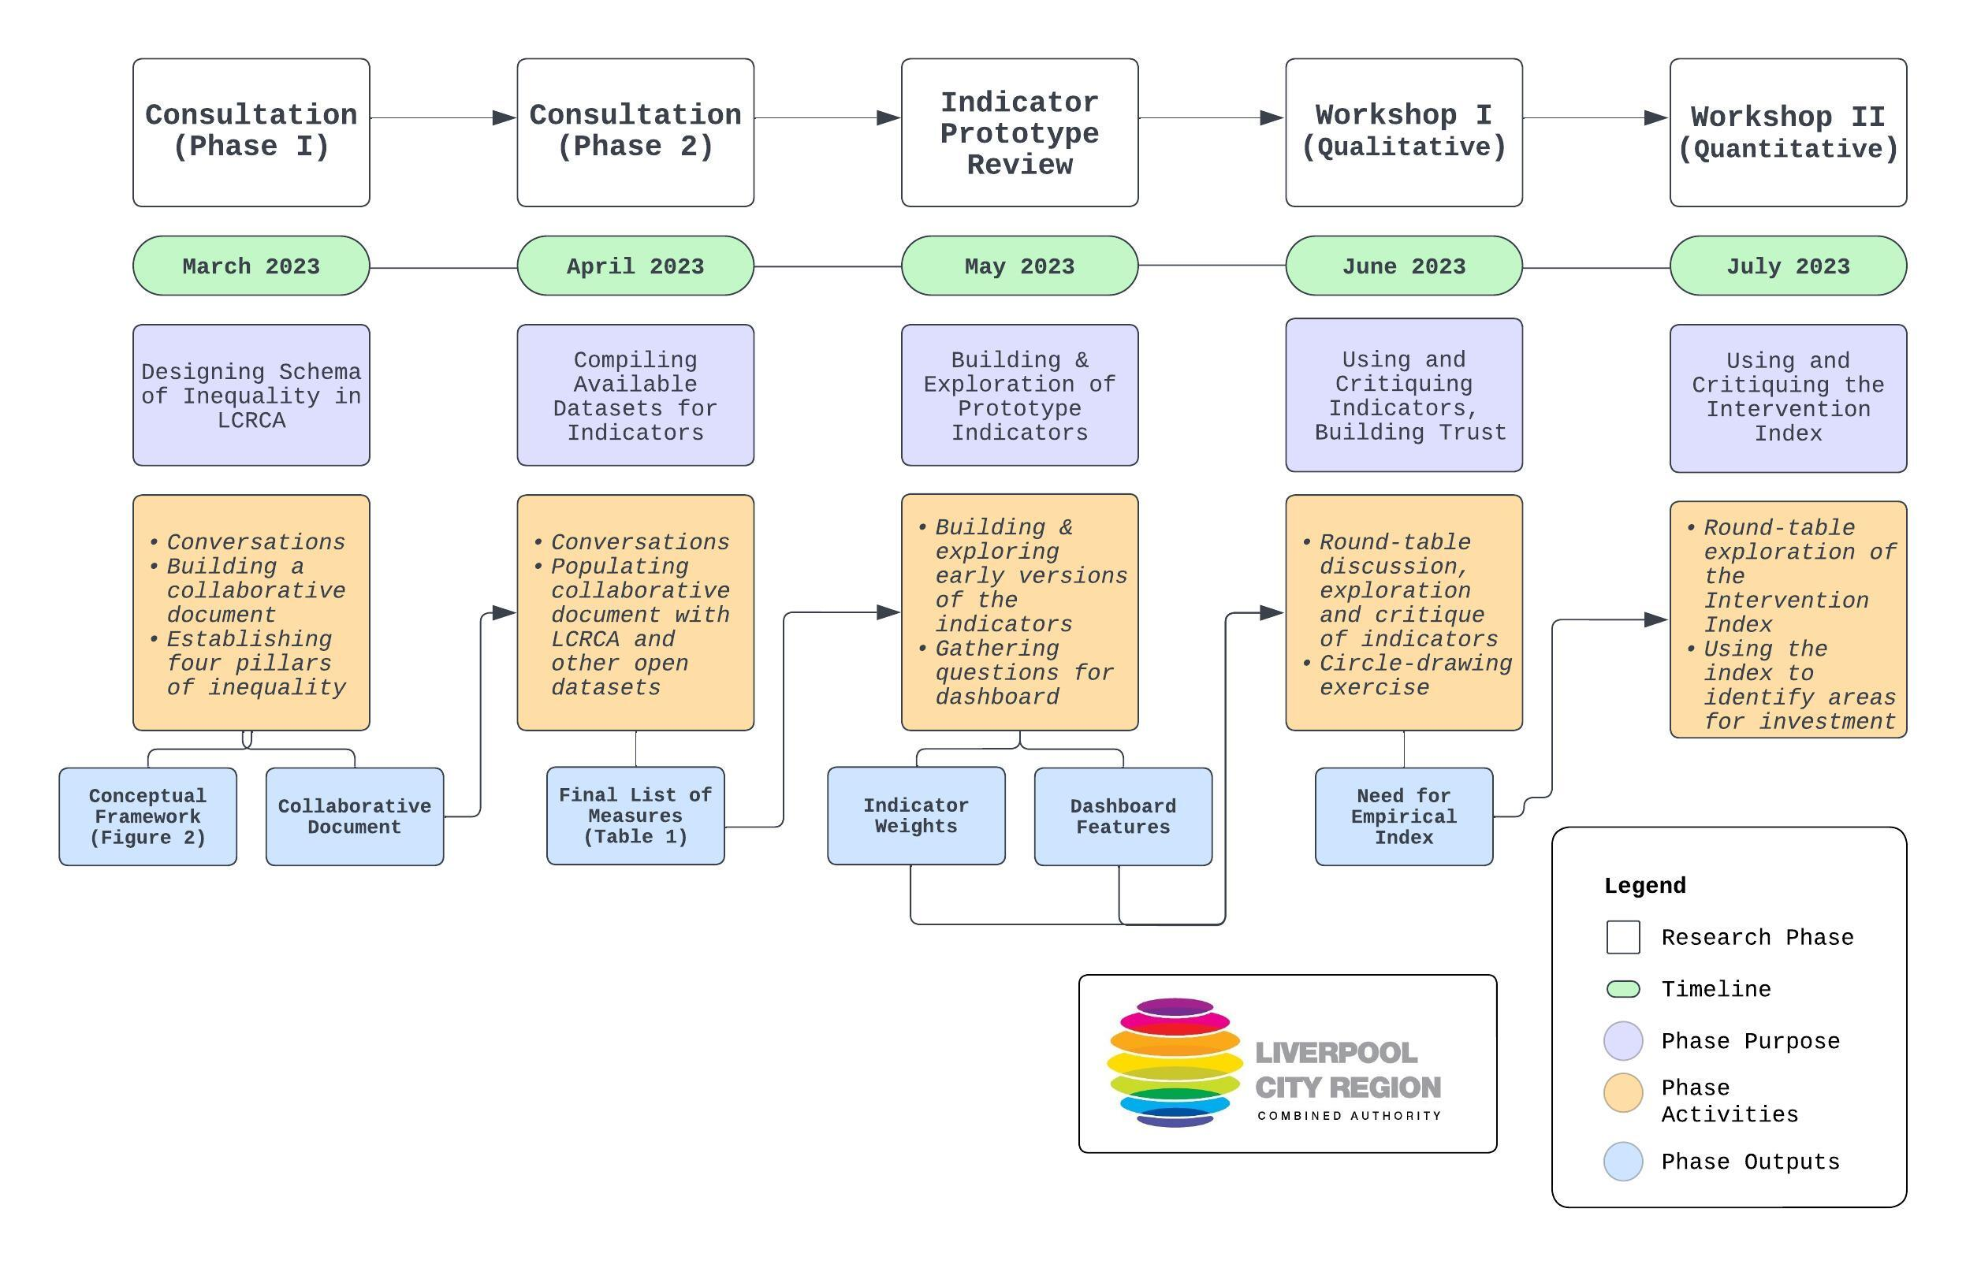
Approach

Slide 4
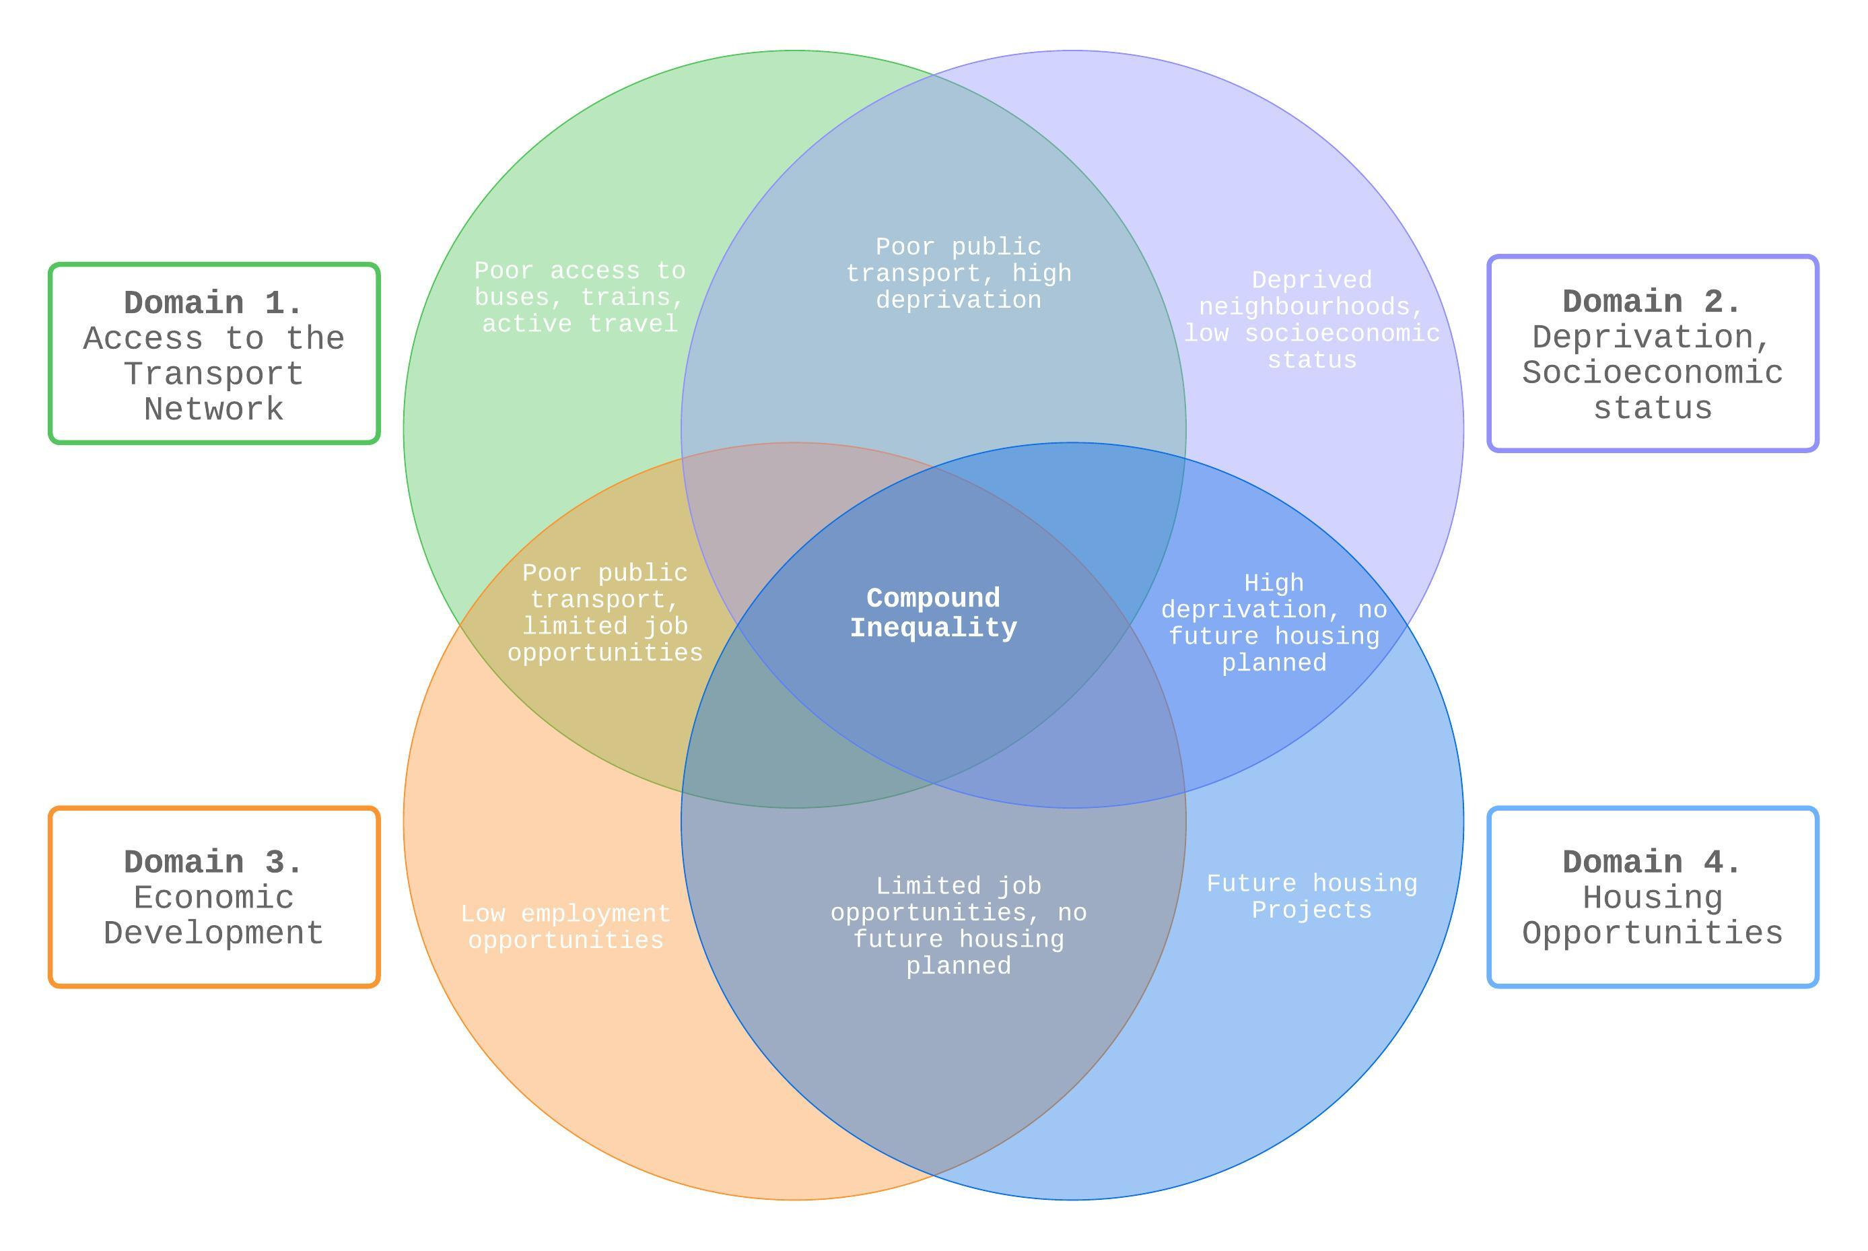
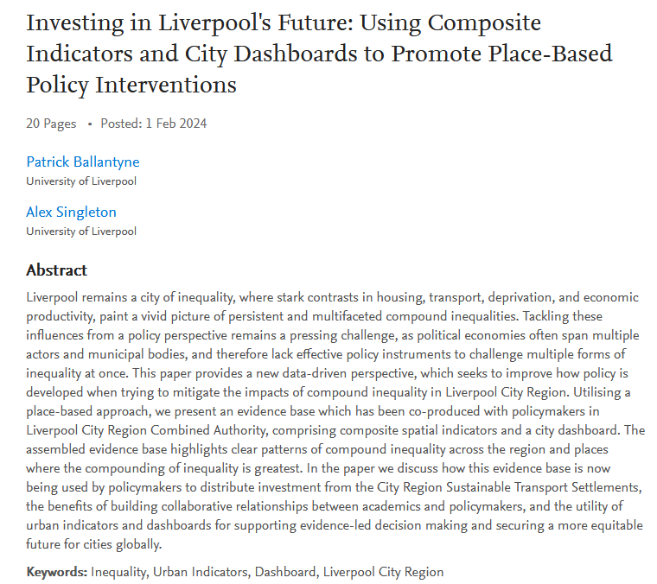
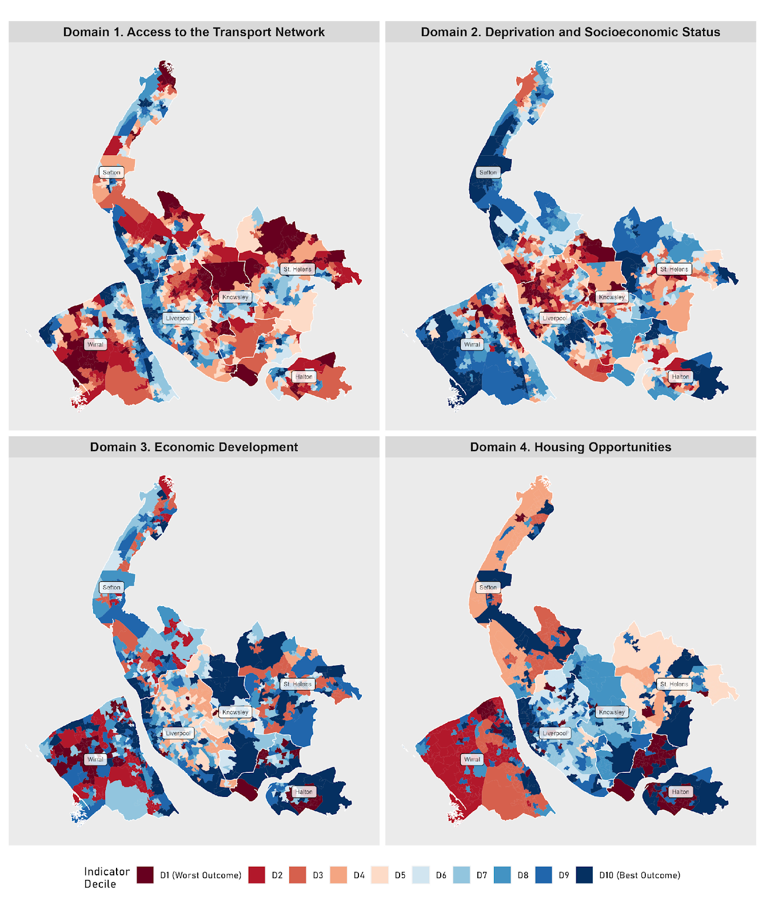
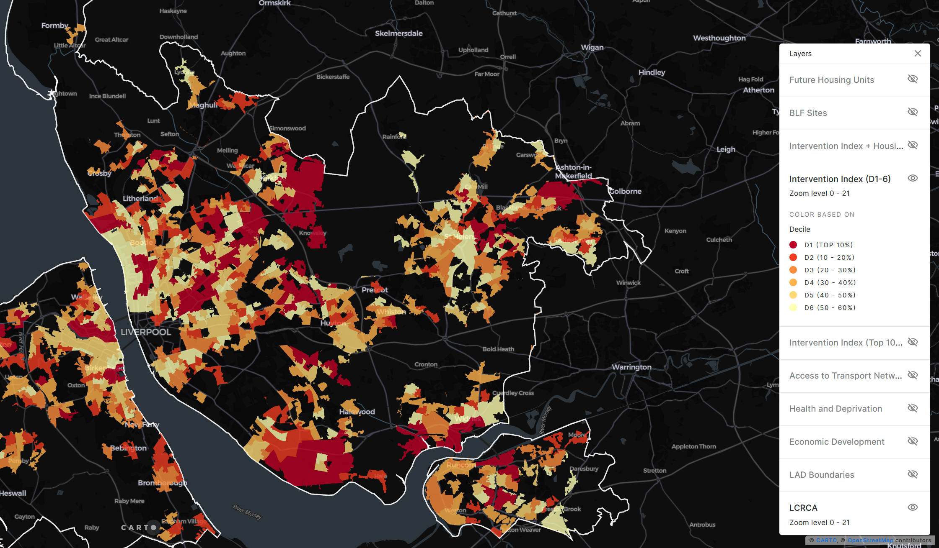
Pre-print at: https://tinyurl.com/ui-lcr
Project Overview

Slide 5
Approach

Slide 6
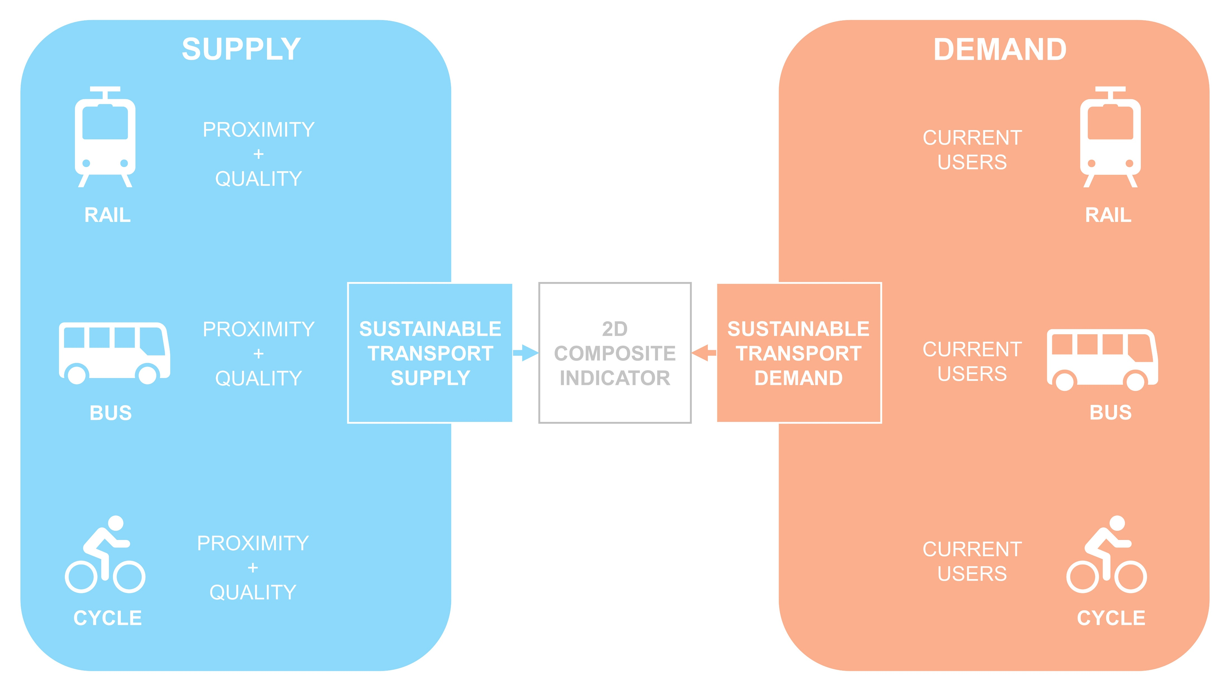
Ballantyne, P., Filomena, G., Rowe, F., Singleton, A. under review. Developing two-dimensional accessibility indicators at small area levels to promote sustainable transport equity.
Towards Two-Dimensional Transport Accessibility Indicators

Slide 7
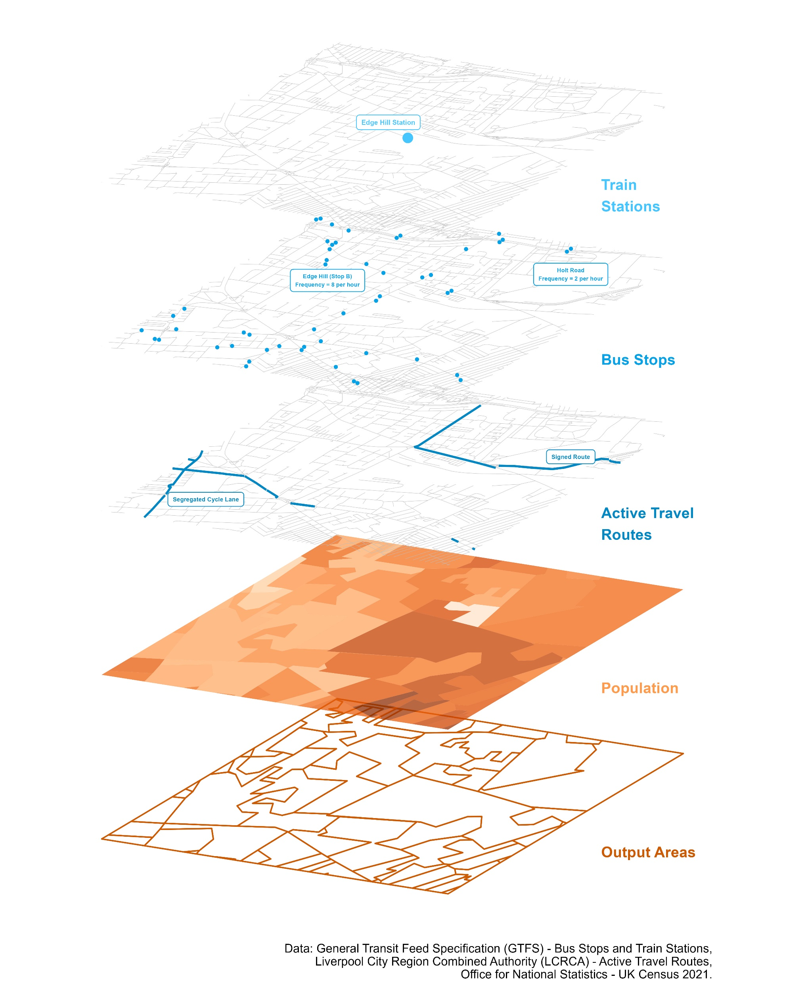
A_{i,j}
= Better Infrastructure Needed
Towards Two-Dimensional Transport Accessibility Indicators

Slide 8
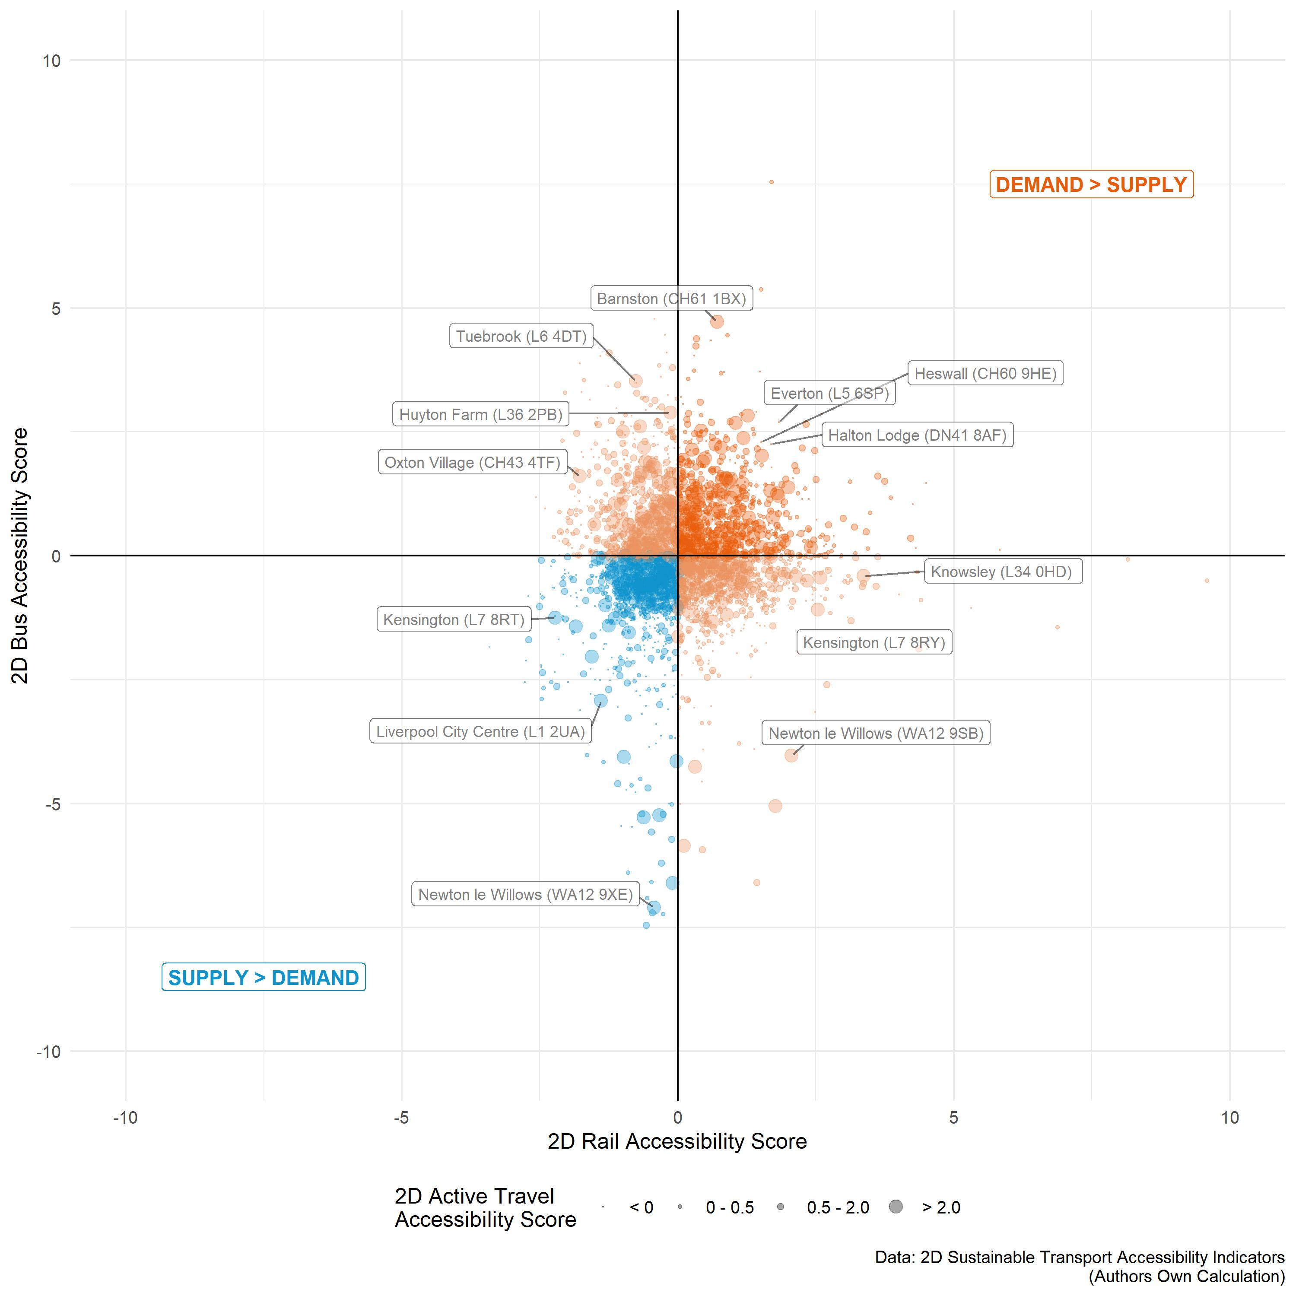
Using Two-Dimensional Transport Accessibility Indicators

Slide 9
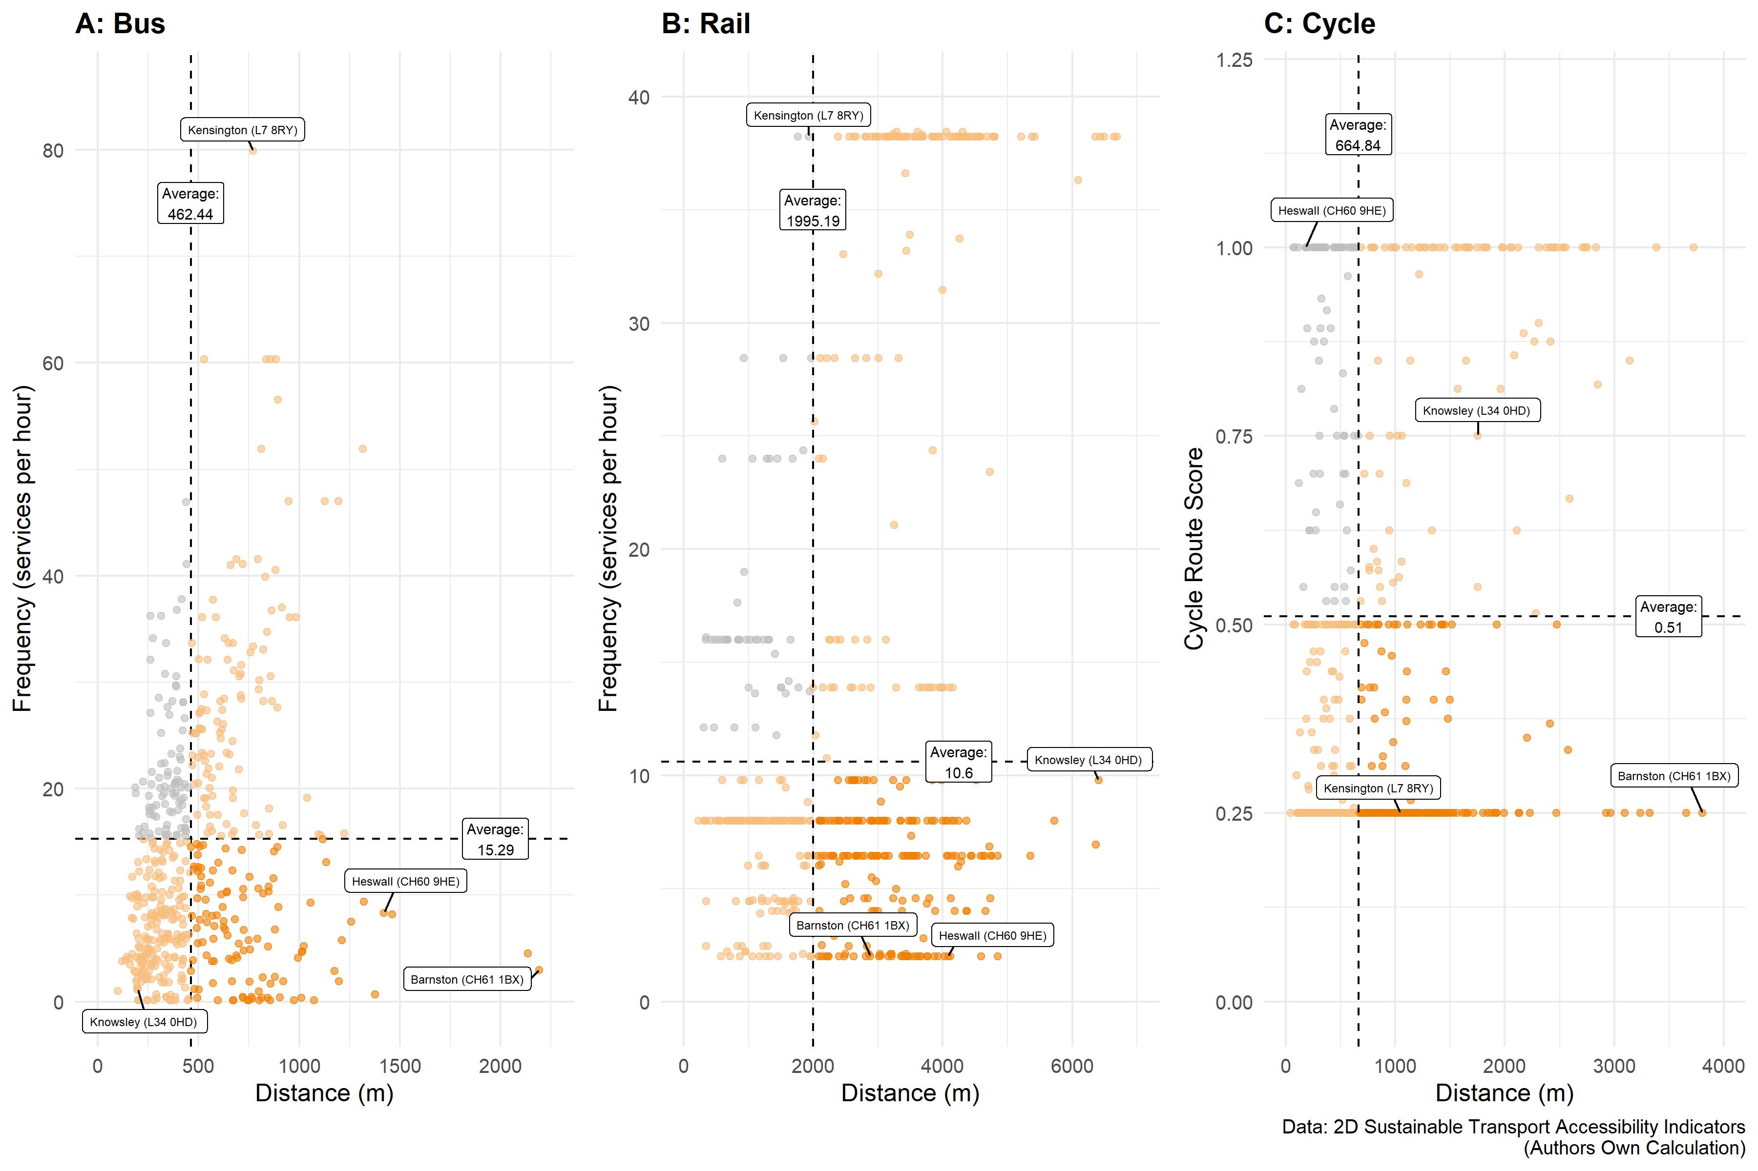
Using Two-Dimensional Transport Accessibility Indicators

Slide 10
Towards ‘place-based’ investment
2027 – 2032: Estimated £1.6 billion for LCRCA.
LCRCA have identified eight priority neighbourhoods for investment, using the urban indicators developed as part of this research project.
A transformative time for Liverpool City Region
Recognising the value in place-based policymaking.
Evidence-led decision making towards an equitable and sustainable future for the region.
Urban indicators for evidence-led policy
Summarising complex relationships in meaningful representations for non-academic audiences (Boeing et al., 2022).
A new conceptual and analytical framework, which can support equitable, sustainable transport networks globally
Reflections & Impact Generation

Slide 11
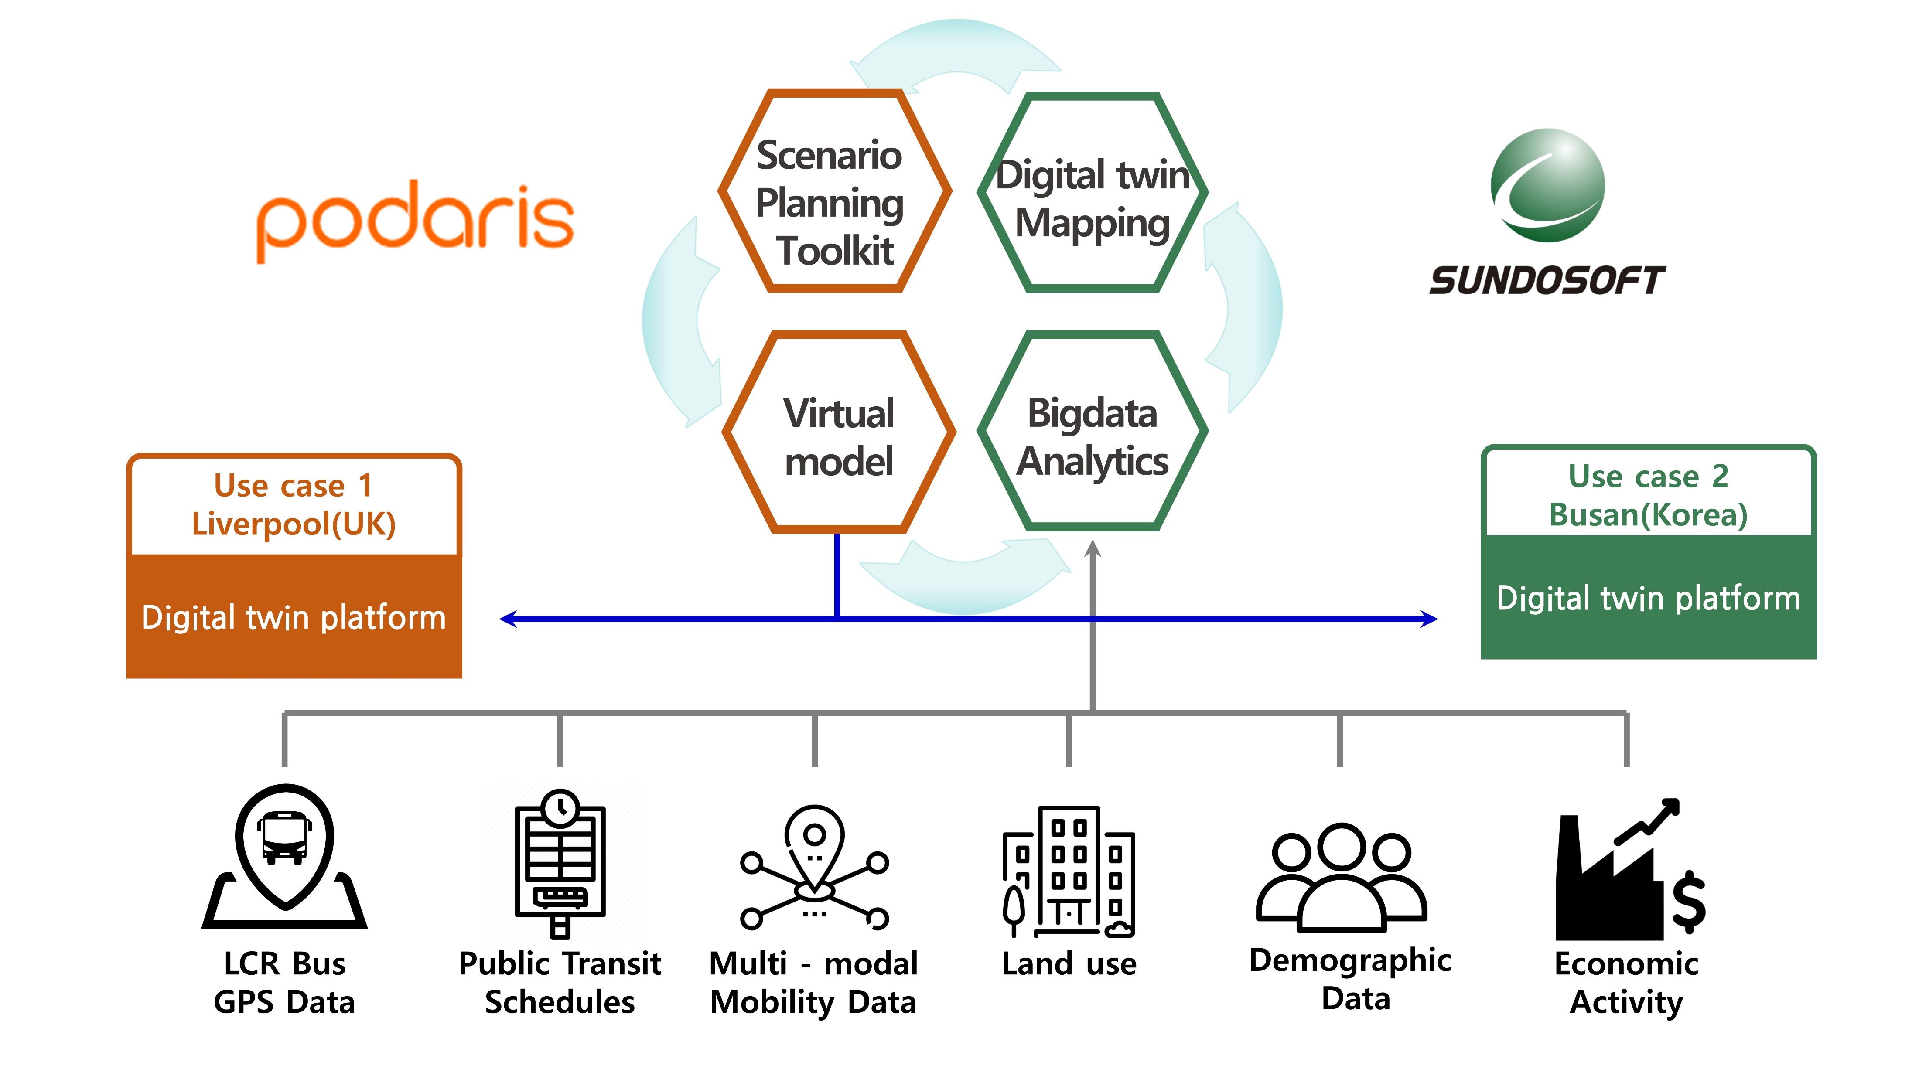
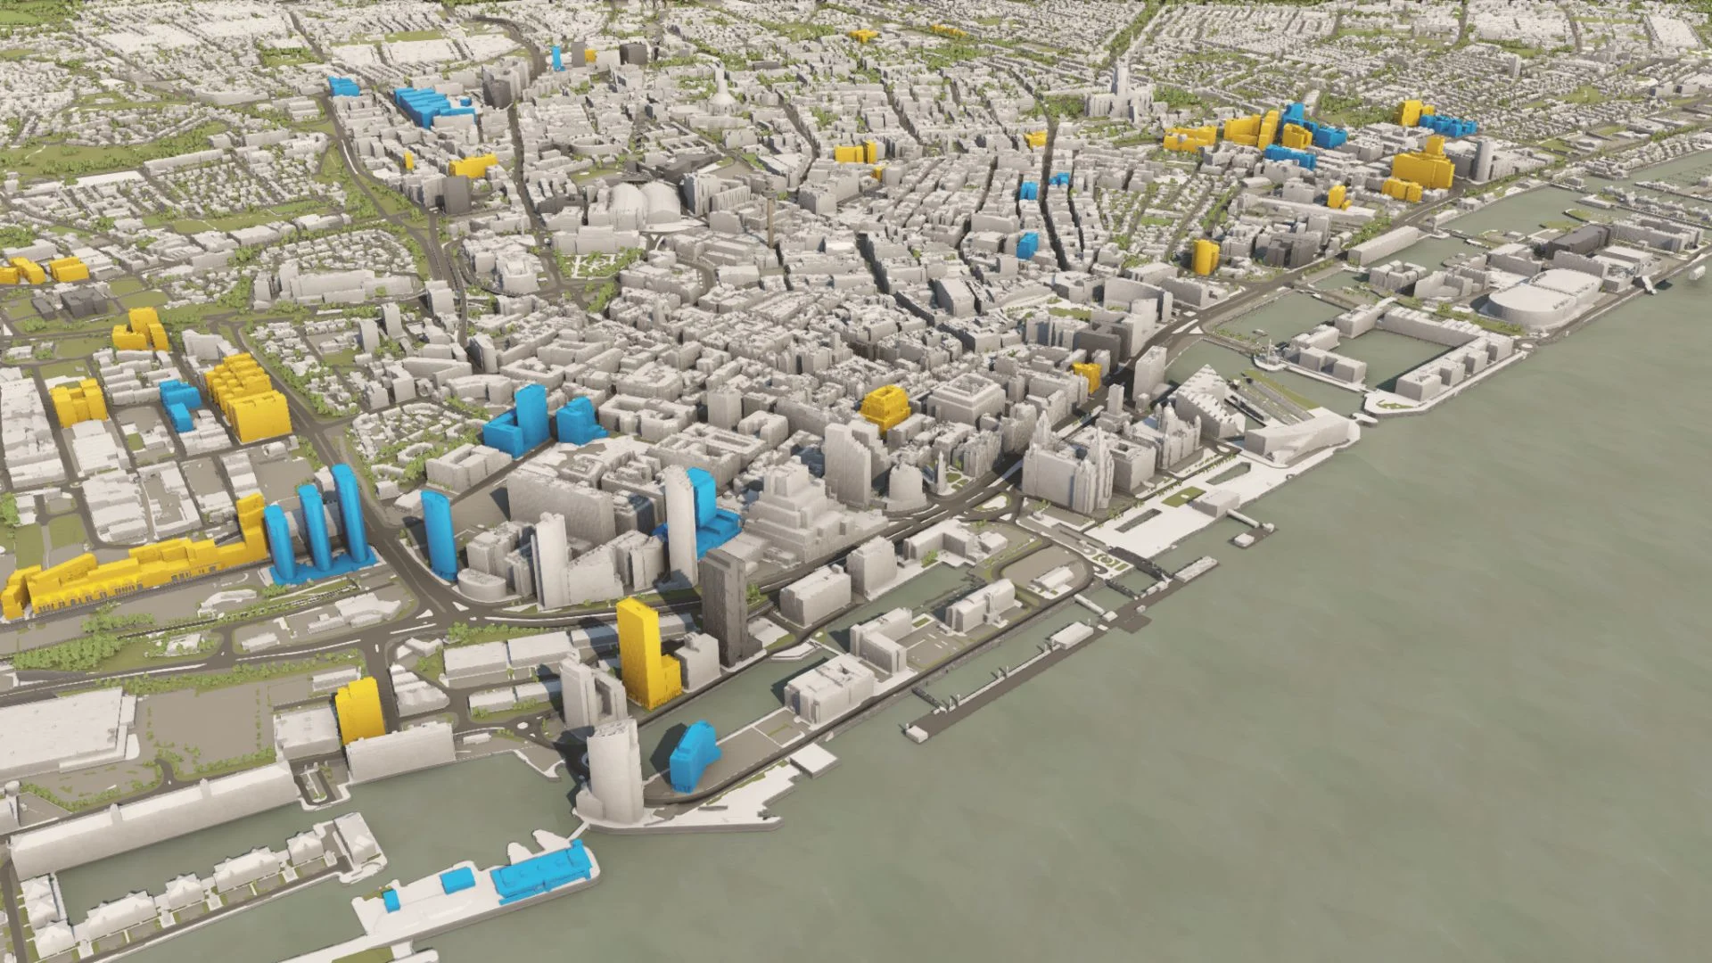
A Big Data Digital Twin of Mass Transit in Liverpool City Region for Smart, Equitable Mobility
A cross-sector, inter-disciplinary research collaboration
Funder: UK Innovate & Korean Agency for Infrastructure Technology Advancement
Funding: £118,387 (Phase I), c. £500,000 (Phase II)
Project Team: Dr. Heeseo Kwon (PI), Dr. Patrick Ballantyne (Co-I)
Project Consortium: Podaris, Liverpool City Region Combined Authority, University of Liverpool (UK), Sundosoft, Busan Metropolitan Government, Pusan National University (Korea)
A ‘Smart’ Liverpool City Region

Slide 12
Using Urban Indicators to Deliver a Sustainable and Equitable Future for Liverpool City Region AAG Annual Meeting 2024, Honolulu Geography and Data Science for Public Good II: Data-Driven Evidence and Solutions to Social and Spatial Inequalities Patrick Ballantyne, Alex Singleton, Gabriele Filomena, Francisco Rowe Geographic Data Science Lab, University of Liverpool In collaboration with Liverpool City Region Combined Authority (LCRCA)

